Slide 1
Critical Thinking & our new AI World
Kate Norris
2025-01-23

Slide 2
Katherine (Kate) Norris
Assistant Scholar and full-time faculty since 2016, at the University of Florida - GeoPlan Center. Kate is a Geospatial Data Manager & Senior GIS Specialist, who holds a Master’s Degree in Urban and Regional Planning, with a specialization in Planning Information Systems and a certification in Interdisciplinary Geographic Information Systems. Kate is an experienced geospatial professional who supports research, teaching, and service at the Center.
URP6275: Intermediate Planning Information Systems
knorris@ufl.edu

Slide 3
University of Florida GeoPlan Center
Established in 1984. Geospatial research and teaching center in the School of Landscape Architecture & Planning.
We support land use, transportation, and environmental planning in Florida with our geospatial expertise.
We build data and tools to inform planning decisions.
We train undergrad + grad students (they are seeking internships & jobs!).
https://www.geoplan.ufl.edu/
https://fgdl.org/

Slide 4
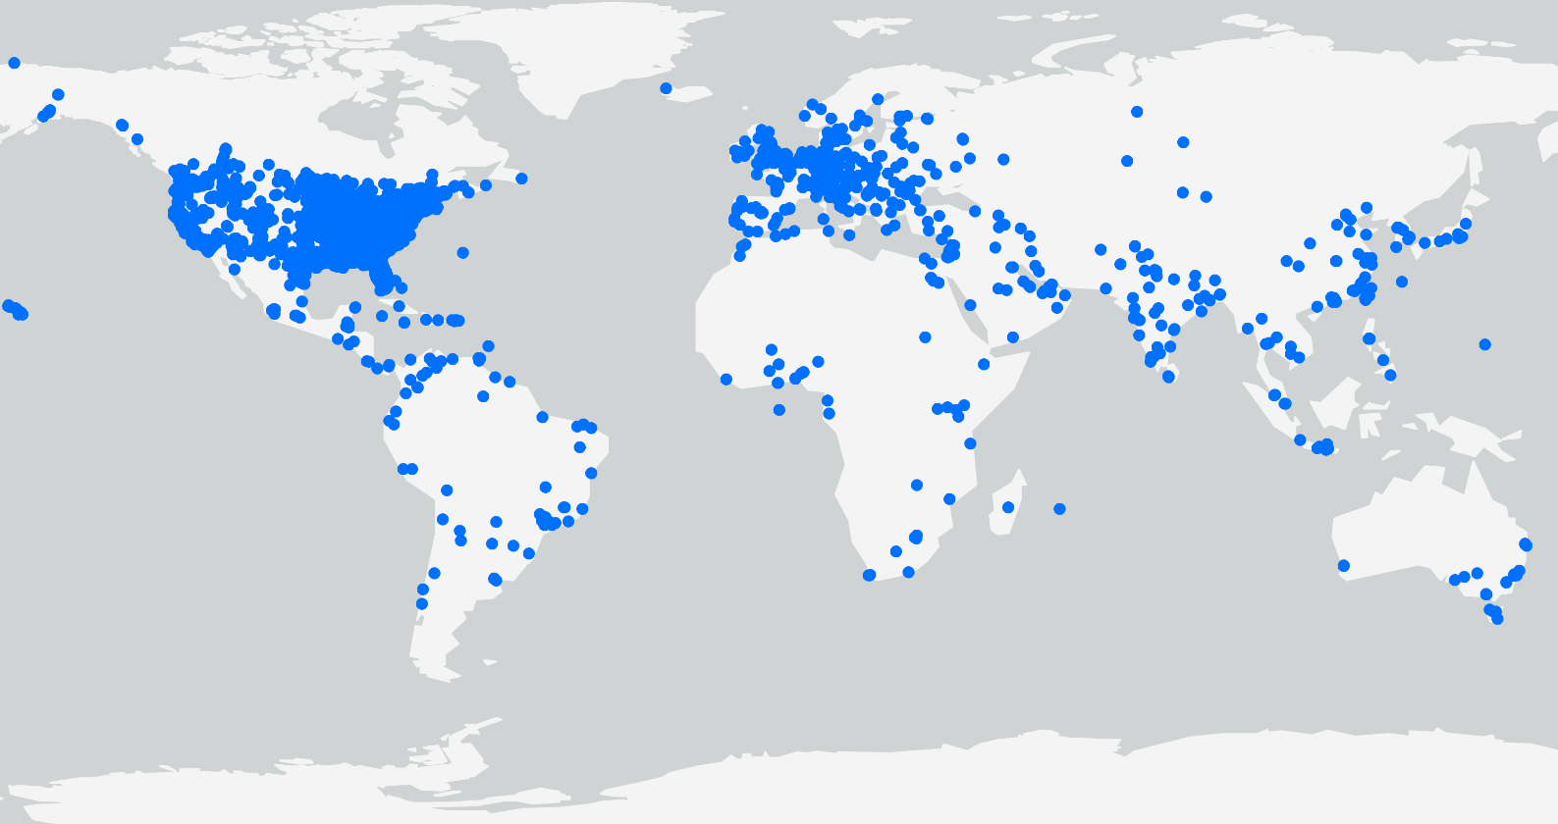
Florida Geographic Data Library: Powering Research in Florida & Beyond
500+
Launched in 1998, FGDL is a collection of standardized and documented geospatial layers for Florida.
Current Layers
4800+
Archive Layers
> 0.5 M
Downloads
since 2012

Slide 5
GIS Project: Data Management
Data Collection and Tracking
Table Example: GIS_Project_Data_Management_Table_20250115.xlsx
QR Code: https://adhoc.geoplan.ufl.edu/downloads/kate/GIS_Project_Data_Management/
Garbage In, Garbage Out (GIGO)
Accessing and Reviewing Metadata
Critical Thinking and Dirty Data (tabular and spatial)
Data Clean-up and Documentation
“CYA” ~ Dr. Paul Zwick
Don’t make assumptions about downloaded data
Know what the data was originally created for
Look things up, do some digging, and read the metadata

Slide 6
Problem 1: Dirty Data & dirty Models

Slide 7
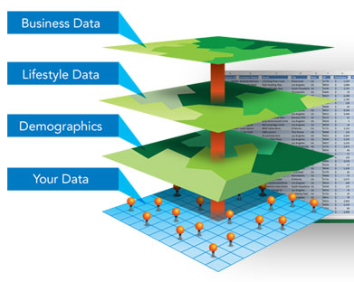
Dirty Data and its Effects on AI & GIS Quality
What is Dirty Data?
Erroneous or incomplete information within a database, or other computer program/system.
What is Data Quality?
“Data quality refers to the condition of a set of values of qualitative or quantitative variables.”(8)
Generally, data is considered high quality if it is "fit for [its] intended uses in operations, decision making and planning.”(9)
Image used with permission. Copyright © 2017 Esri. All rights reserved. [https://www.arcgis.com/features/img/location-analytics/features-location_gain-new-insights.jpg]
Notes:
Dirty Data can be defined as erroneous or incomplete information within a database, or other computer program/system. Dirty Data comes in many formats; however, its effects are always the same, a negative impact on data quality. Dirty Data is usually the result of user error or haphazard data collection, additionally inappropriate data management and storage can also play a factor. GIS Projects and Systems may be affected by the following examples of different Dirty Data types.
What is Dirty Data?
Dirty Data can be defined as erroneous or incomplete information within a database, or other computer program/system.
What is Data Quality?
“Data quality refers to the condition of a set of values of qualitative or quantitative variables.” (8)
In general data is considered high quality if it is "fit for [its] intended uses in operations, decision making and planning.”(9)

Slide 8
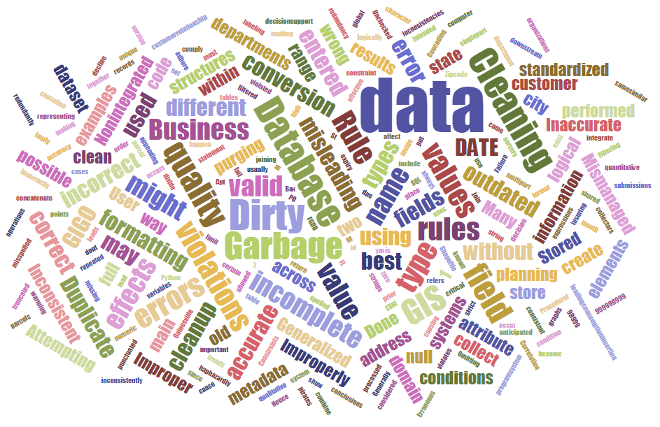
Examples of Different Dirty Data Types
Business Rule Violations
Data Rule Violations (Data Errors)
Data without Generalized Formatting
Duplicate Data
Inaccurate Data
Incomplete Data
Inconsistent Data
Incorrect Data
Misleading Data
Non-Integrated Data
Outdated Data
Mismanaged or Improperly Stored Data
Notes:
In this presentation we will review the following examples of dirty data types

Slide 9
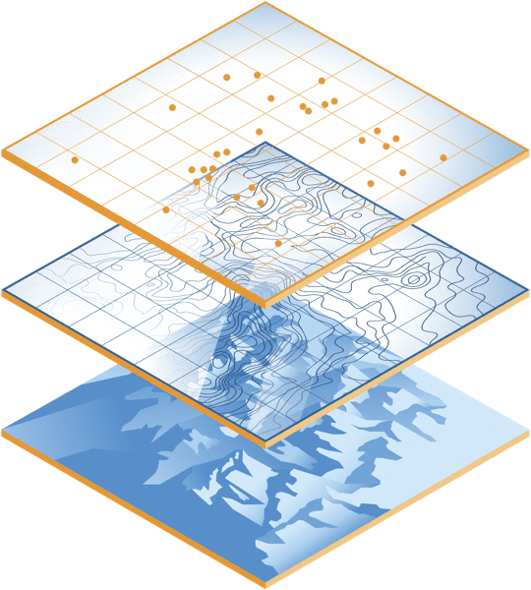
Recognizing Geospatial Dirty Data
Recognizing Geospatial Dirty Data
Examples of Different Geospatial Dirty Data Types
Geocoding Locational Errors
Address Matching Issues
Attribute versus Spatial Selections
Inconsistent Data
Various Locational Issues
Mismanaged Data
Large Data Files
Image used with permission. Copyright © 2017 Esri. All rights reserved. [https://www.esri.com/about/newsroom/wp-content/uploads/2021/02/arcgisplatform-mapsanddata.png]

Slide 10
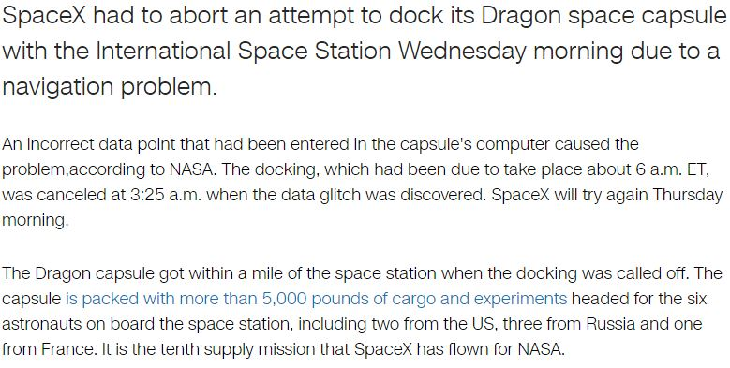
Recognizing Geospatial Dirty Data
Source: http://money.cnn.com/2017/02/22/technology/spacex-abort-docking-space-station/index.html
Notes:
Geospatial dirty data can create large real world problems and increase costs. In the CNN article “SpaceX aborts space station docking” an incorrect data point programmed within the Dragon space capsule’s computer system lead to an aborted docking attempt at the international space station.

Slide 11
Data Quality: The Risks Of Dirty Data And AI
“An artificial intelligence (AI) is only as useful as the data used to train it. Training AI with dubious data leads to questionable decisions.”
“According to a 2017 Harvard Business Review study, almost every company has data quality shortfalls. Nearly half have data quality issues entailing clear and negative business consequences.”
“Data biases and data hygiene problems can have short- and long-term consequences—consequences that are not necessarily evenly distributed.”
“The problem isn’t the algorithm, but the dirty data fed into it. That data is, in turn, the product of conscious or unconscious biases in our society.”
https://www.forbes.com/sites/intelai/2019/03/27/the-risks-of-dirty-data-and-ai/

Slide 12
Garbage In, Garbage Out (GIGO)
Dirty Data in a AI or a GIS project can create a “Garbage In, Garbage Out (GIGO)” scenario where the effect of a dataset’s issue is compounded and embedded within a whole new dataset or analysis result(s).
Unknown Garbage Out results may have long standing impacts if planning and legislative decisions are based on them.
“The Data Warehousing Institute (TDWI) estimates that dirty data costs U.S. businesses more than $600 billion each year.”(3)
https://openclipart.org/detail/195034/garbage-truck
Notes:
Dirty Data in a GIS project can create a “Garbage In, Garbage Out (GIGO)” scenario where the effect of a dataset’s issue is compounded and embedded within a whole new dataset or analysis result(s).
Unknown Garbage Out results may have long standing impacts if planning and legislative decisions are based on them.
“The Data Warehousing Institute (TDWI) estimates that dirty data costs U.S. businesses more than $600 billion each year.”(3)

Slide 13
In The Age Of AI, Critical Thinking Is More Needed Than Ever
Feyaza Khan, an editor of AI training data at Toloka, explains, “AI is undeniably getting better, but it still requires a lot of human labor behind the scenes to ensure that the models put out quality responses. Writers and editors who work with AI must have strong critical thinking skills to objectively evaluate the content for accuracy, while also making improvements so that it will sound more human. Good AI can’t learn from itself. High-quality, responsible and accurate AI will continue to rely on human intervention to actually learn new things and generate quality content.”
Khan explains, “Fact-checking, source analysis and other critical thinking skills are crucial for properly training AI. These applications of critical thinking, especially when combined with an AI trainer's own expertise, make all the difference in ensuring accuracy and preventing bias. Yes, LLMs can offer amazing output. But human expertise and oversight – especially those critical thinking skills – are essential to guide AI capabilities in the right direction.”
https://www.forbes.com/sites/roncarucci/2024/02/06/in-the-age-of-ai-critical-thinking-is-more-needed-than-ever/

Slide 14
You're facing data inconsistencies in GIS. How can critical thinking skills guide you to resolution?
Identify Errors - When you notice discrepancies in your GIS data, the first step is to identify the errors. This involves scrutinizing the data sets and comparing them against known standards or benchmarks. You should look for patterns or anomalies that suggest a systematic issue.
Question Sources - Where did the data come from? Who collected it and how was it processed? Understanding the origin of the data helps you assess its reliability and determine potential causes for inconsistencies. If the data was collected using different methodologies or at different times, this might explain the discrepancies. Critical thinking involves not taking data at face value but evaluating the context in which it was gathered.
Analyze Context - You need to consider external factors that might affect the data quality, such as environmental changes or technological limitations at the time of collection. For instance, a historical land use dataset may not accurately reflect current conditions due to urban development or natural events.
Evaluate Solutions - This may involve correcting the data manually, using software tools to automate error detection and correction, or integrating different data sources to cross-verify information. Each option has its pros and cons, and your critical thinking skills will help you weigh these against the specific requirements of your project to choose the most effective approach.
Implement Changes - This might mean updating data entries, recalibrating datasets, or redefining parameters within your GIS software. It's important to document each step of the process for transparency and future reference. As you make these adjustments, continually assess their impact on the overall dataset to ensure that one correction doesn't introduce new errors elsewhere.
https://www.linkedin.com/advice/3/youre-facing-data-inconsistencies-gis-dz7he

Slide 15
FLUF Test Critical Evaluation Framework for Artificial Intelligence ​Improving Prompts and Assessing AI Generative Results
FLUF Test: A Framework for Critical Evaluation of Content Generated with Artificial Intelligence © 2023 by Dr. Jennifer L. Parker is licensed under CC BY-NC-SA 4.0.
“The FLUF Test is a framework for critically evaluating content generated through artificial intelligence. The framework encourages the user to look critically at format, language, usability, and fanfare when considering the outputs of the AI generated results. AI generated results can be flowery or inaccurate – or repetitive for example. Using AI tools brings with it a responsibility to be educated about their power, usefulness, and shortcomings.”
https://www.drjenniferparker.com/fluf-test-for-artificial-intelligence.html

Slide 16
Problem 2: The affects of ai on critical thinking

Slide 17
Study Links Frequent AI Use With Lower Critical Thinking Abilities | IFLScience
“The findings of this study illuminate the complex interplay among AI tool usage, cognitive offloading, and critical thinking. As AI tools become increasingly integrated into everyday life, their impact on fundamental cognitive skills warrants careful consideration. Our research demonstrates a significant negative correlation between the frequent use of AI tools and critical thinking abilities, mediated by the phenomenon of cognitive offloading.”
https://www.mdpi.com/2075-4698/15/1/6
Gerlich, M. (2025). AI Tools in Society: Impacts on Cognitive Offloading and the Future of Critical Thinking. Societies, 15(1), 6. https://doi.org/10.3390/soc15010006

Slide 18
More teens say they're using ChatGPT for schoolwork, a new study finds
A recent poll from the Pew Research Center shows more and more teens are turning to ChatGPT for help with their homework.
3 things to know:
According to the survey, 26% of students ages 13-17 are using the artificial intelligence bot to help them with their assignments.
That's double the number from 2023, when 13% reported the same habit when completing assignments.
Comfort levels with using ChatGPT for different types of assignments vary among students: 54% found that using it to research new topics, for example, was an acceptable use of the tool. But only 18% said the same for using it to write an essay.
https://www.npr.org/2025/01/18/g-s1-43115/chatgpt-teen-school-homework-classroom-ai

Slide 19
The Dark Side Of AI: Tracking The Decline Of Human Cognitive Skills
Declining Cognitive Skills in Education
“The effects of AI on cognitive development are already being identified in schools across the United States. In a report titled, “Generative AI Can Harm Learning”, researchers at the University of Pennsylvania found that students who relied on AI for practice problems performed worse on tests compared to students who completed assignments without AI assistance. This suggests that the use of AI in academic settings is not just an issue of convenience, but may be contributing to a decline in critical thinking skills.”
https://www.forbes.com/sites/chriswestfall/2024/12/18/the-dark-side-of-ai-tracking-the-decline-of-human-cognitive-skills/
https://edsource.org/updates/students-using-artificial-intelligence-did-worse-on-tests-experiment-shows

Slide 20
Why This Matters Now
“If schools don’t revamp curricula to emphasize how to engage with AI critically, they risk graduating individuals unprepared for future work. Skills such as framing iterative questions, validating AI outputs against reliable sources, and identifying gaps or biases in AI-generated data should be central to modern education.”
Critical thinking needs to be taught hand in hand with AI
https://www.forbes.com/sites/niritcohen/2025/01/19/beyond-prompts-critical-thinking-is-your-edge-when-everyones-using-ai/

Slide 21
How can we educate and equip students to be the most promising job candidates and have the most successful careers in our AI-driven future?
5 Soft Skills You Need to Thrive in the Age of AI
Strategic Thinking
Communication Skills
Honesty And Integrity
Critical Thinking
“While AI can recognize patterns and automate tasks, the human mind excels at critical thinking and problem-solving. Moving forward, organizations will still need people to define goals, make strategic decisions and assess risks. This highly valued soft skill involves the ability to analyze and interpret information in a logical way. Critical thinking allows individuals to make educated decisions based on hard data rather than emotion. Employees with strong critical thinking skills also tend to be good problem solvers and communicators.”
Adaptability
https://www.forbes.com/sites/carolinecastrillon/2025/01/19/5-soft-skills-critical-in-the-age-of-ai/

Slide 22
Beyond Prompts—Critical Thinking Is Your Edge When Everyone’s Using AI
Mastering Critical Thinking with AI - Like any skill, it takes practice to engage critically with the ideas and outputs developed in partnership with AI tools. The AI generated output is not the end of your process, it’s the beginning. To think critically and layer your own perspectives to generate your personalized AI-aided content, it helps to consider these guiding questions:
1. What assumptions or biases underpin the output? Are there any gaps in the data the AI relied on? How can you challenge these assumptions?
2. What perspectives might be missing? Look for voices, arguments, or viewpoints that the AI may have overlooked. How might including these perspectives strengthen the analysis?
3. Does the output align with or challenge existing ideas? Use AI to explore counterarguments or alternative perspectives, ensuring a more nuanced understanding.
4. Is the information consistent and accurate? Cross-reference AI outputs with reliable sources to validate the data and identify any discrepancies. What gaps remain, and how might you address them?
5. How does the iterative process refine your thinking? Actively seek deeper engagement with your work. Reflect on how each iteration improves the quality of your arguments and understanding, possibly opening up new avenues to explore.
By asking these questions and iterating on the outputs, you not only ensure accuracy but also develop a deeper, more thoughtful perspective. Engaging critically with AI in this way transforms it from a simple tool into a collaborator that enhances your learning and creativity.
https://www.forbes.com/sites/niritcohen/2025/01/19/beyond-prompts-critical-thinking-is-your-edge-when-everyones-using-ai/

Slide 23
Questions
How do you plan on incorporating AI along with Critical Thinking in your class or research lab?
What are you currently seeing with regard to critical thinking in your class room or research lab?
What are your concerns?
What are your lessons learned?
What are your questions?

