Slide 1
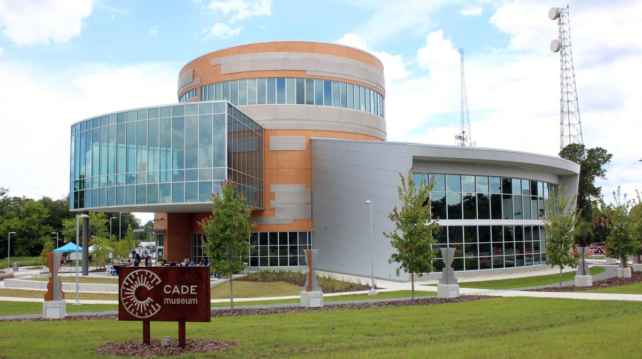
Urban & Regional Planning
DCP 1003 Creating Our Built Environment
Kate Norris, Assistant Scholar
Geospatial Data Manager & Senior GIS Specialist, UF GeoPlan Center
UF Department of Urban and Regional Planning
March 3rd, 2026

Slide 2






University of Florida
GeoPlan Center
Established in 1984. Geospatial research and teaching center in the School of Landscape Architecture & Planning.
We support land use, transportation, and environmental planning in Florida with our geospatial expertise.
We build data and tools to inform planning decisions.
We train undergrad + grad students (they are seeking internships & jobs!).
https://www.geoplan.ufl.edu/

Slide 3
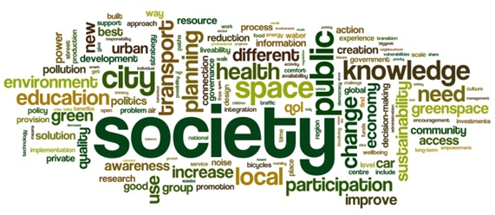
What is Planning?

Slide 4
What is Planning?
Urban Planning is the design and regulation of how space is used in cities and the development of open land, integrating physical layout, economic activity, and social impact. It blends engineering, architecture, and social‑political concerns, functioning as a technical profession, a political endeavor requiring public participation, and an academic field.
Practitioners address both new developments and urban revitalization, employing data analysis, forecasting, design, and GIS mapping, often striving toward sustainable development, meeting present needs without harming future generations, while routinely negotiating trade‑offs among competing objectives.

Slide 5
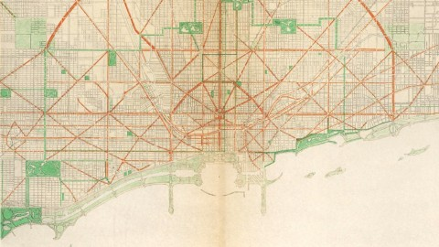
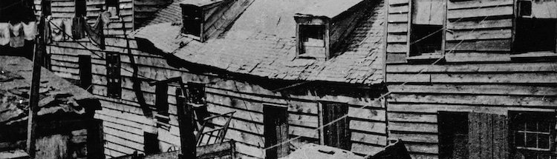
Civic Design: Civic design is the intentional shaping of public spaces, buildings, and infrastructure to foster inclusive, functional, and vibrant community life.
Social Reform: Social reform is the deliberate effort to change laws, policies, or social practices in order to improve fairness, equality, or well‑being for a community or society.

Slide 6
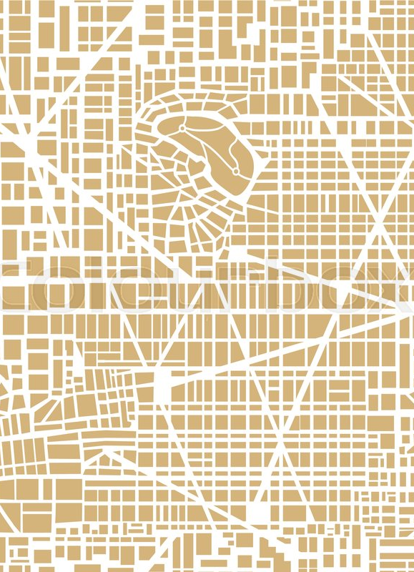
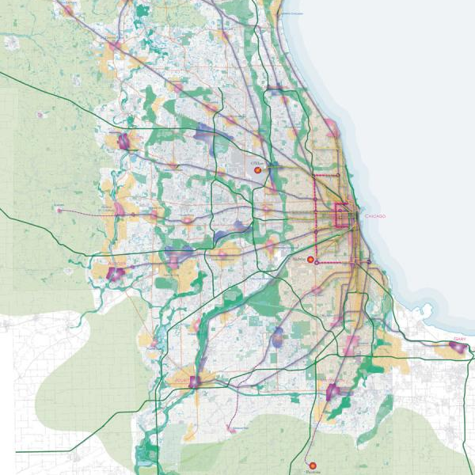
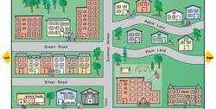
Multiple Scales.
Site. Neighborhood. City. Region. State.

Slide 7
Interconnected Systems.
A
B
A
B
Physical
Political & Social
Buildings
Infrastructure
Public Spaces
Legal
Governmental Structures
Culture & Heritage
C
C
D
D
Natural
Economic
Natural Resources
Ecology
Shape of Land
Financing
Taxation
Economic Development

Slide 8
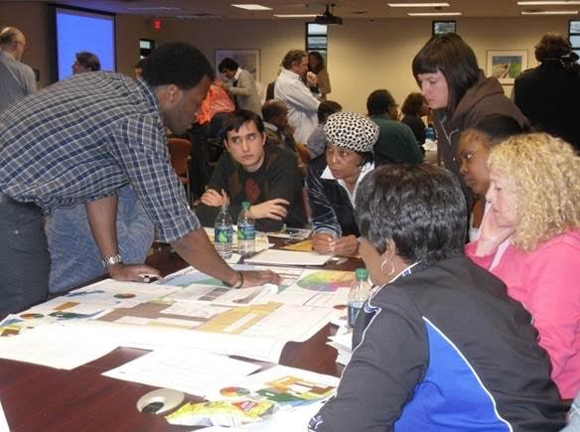
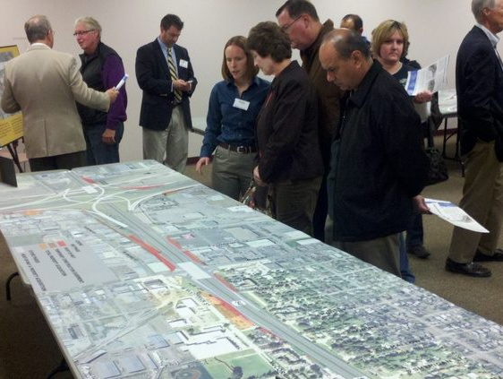
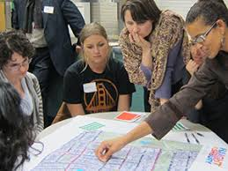
Public Interest.
Source: CEDA Michigan
Source: Kellogg
Source: San Francisco

Slide 9
Community
Planning
Planners
Civil Engineers
Surveyors
Landscape Architects
Architects
Interior Design
Construction Management
Police/Fire/EMS
Schools
Parks
Environmental Scientists
Attorneys
Elected Officials
The Public
Real Estate Developers
Collaboration.

Slide 10






Planning Specializations
Housing & Community Development
Transportation Planning
Comprehensive Planning
Environmental Planning
Economic Development
Urban Design

Slide 11
Planning Trends
Housing Challenges and Solutions
Emerging Forms of Transportation
Political Polarization and Societal Divide
Climate Impacts and Adaptation Challenges
Job Evolution and Revolution
Immersive Cities

Slide 12
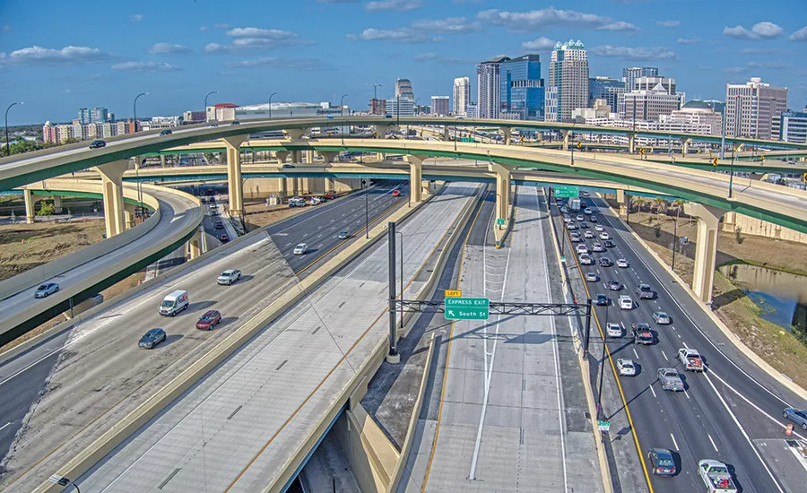
Transportation Challenges.
Notes:
https://www.enr.com/ext/resources/2022/04/26/001-Ultimate-Improvement-Express-Lane-HNTB.webp?t=1675445131

Slide 13

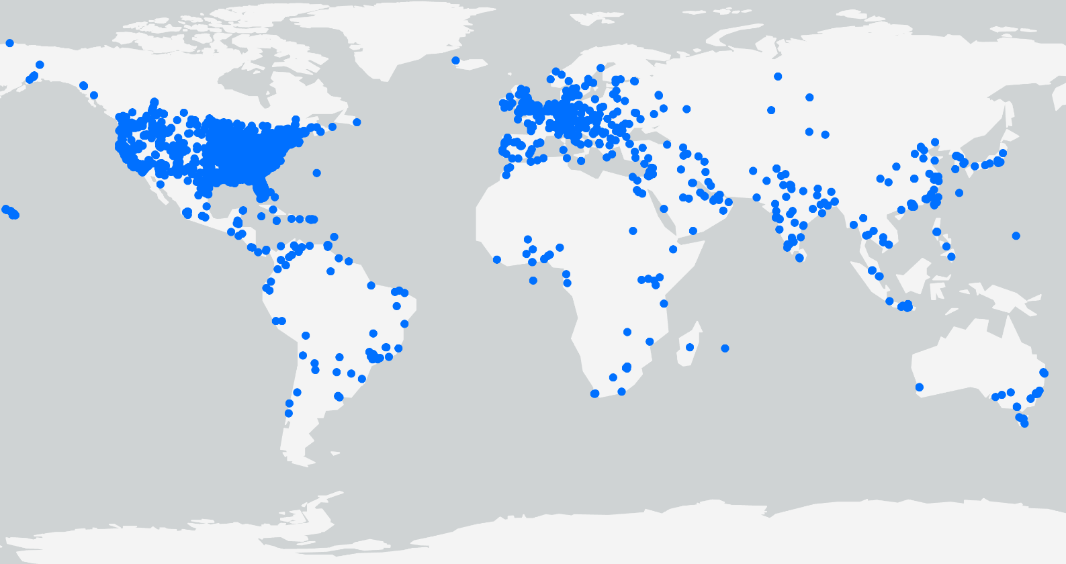

Florida Geographic Data Library: Powering Research in Florida & Beyond
500+
Launched in 1998, FGDL is a collection of standardized and documented geospatial layers for Florida.
Current Layers
4800+
Archive Layers
> 0.5 M
Downloads
since 2012

Slide 14


Environmental Screening Tool
Web application to support Florida DOT’s screening of potential impacts to environmental and human resources from proposed transportation projects.
500+
GIS
Analyses
4000+ active users
20+ years active
$28M
year saved
Social & Economic
Cultural
Natural
Physical
Special Designations
Federal
State
Tribal
Public
Databases:
  Business
  Geospatial
30+ servers
Secure & Public websites
Realized cost savings based off 20% reduction in construction time
https://etdmpub.fla-etat.org/est/

Slide 15
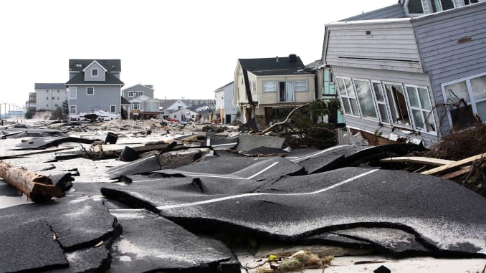
Climate Impacts and Adaptation Challenges.

Slide 16
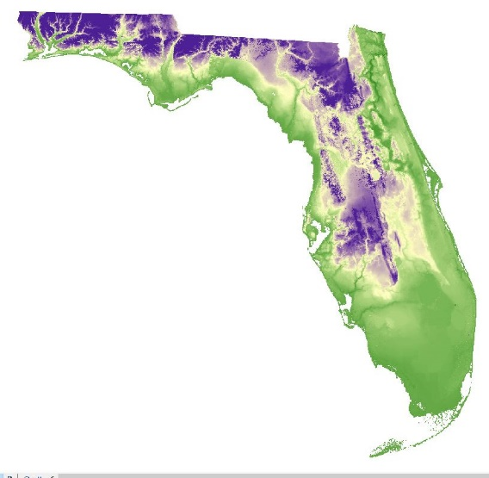
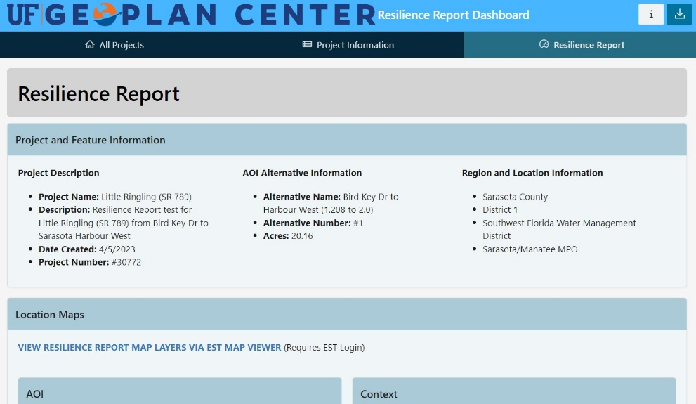
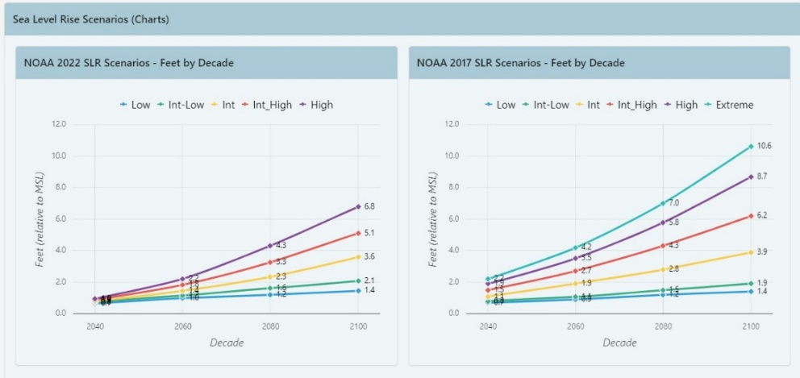
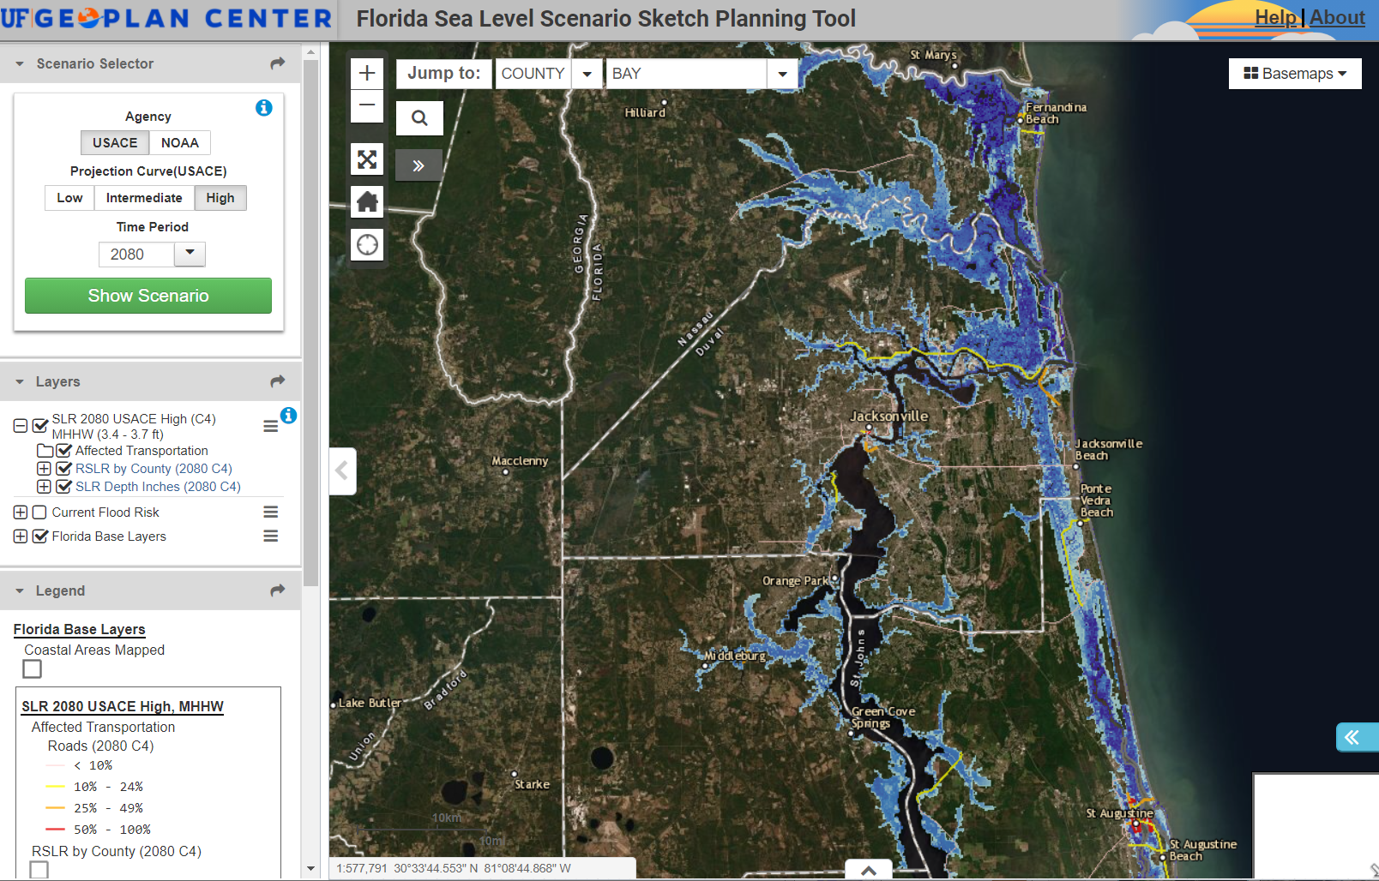
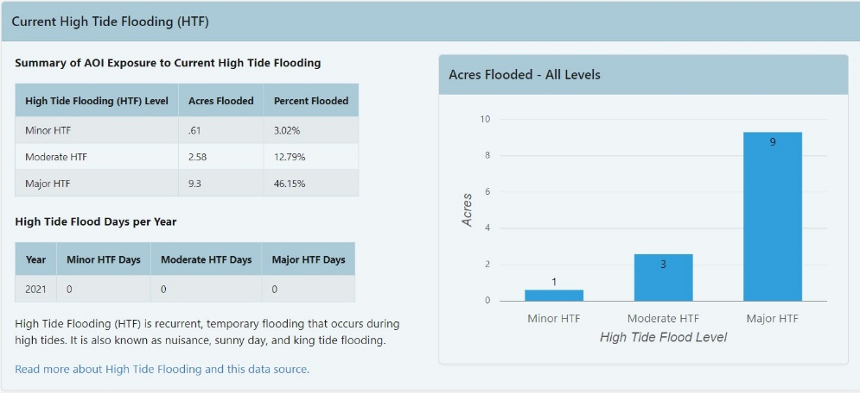
Sea Level Rise Vulnerability
Assessments & Capacity Building
350
50%
Over 350 planning professionals participated in technical training 2016-2020
Over 50% of Florida’s coastline supported through UF data since 2014
sls.geoplan.ufl.edu

Slide 17
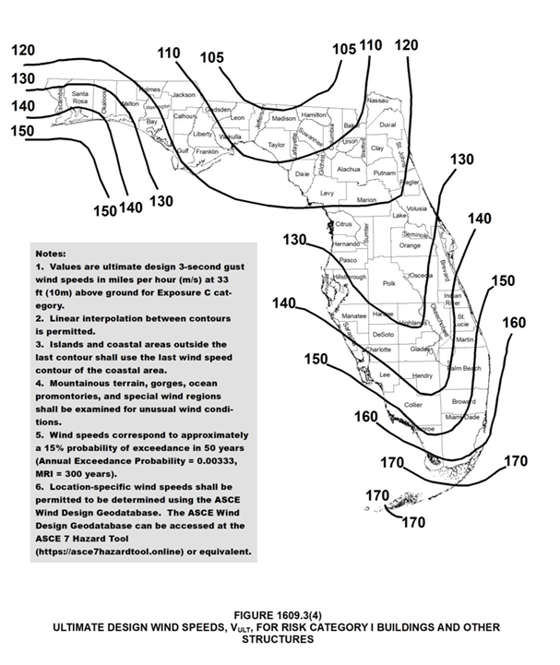
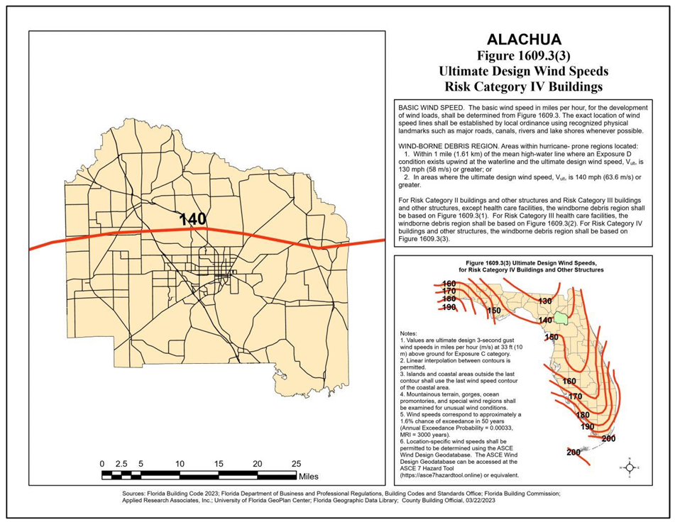

Wind Speed Maps
Updated Wind Speed Line Maps for 2023 Florida Building Code
Maps are used to determine the wind speed requirements for buildings and structures in Florida
https://www.geoplan.ufl.edu/portfolio/wind-speed/

Slide 18
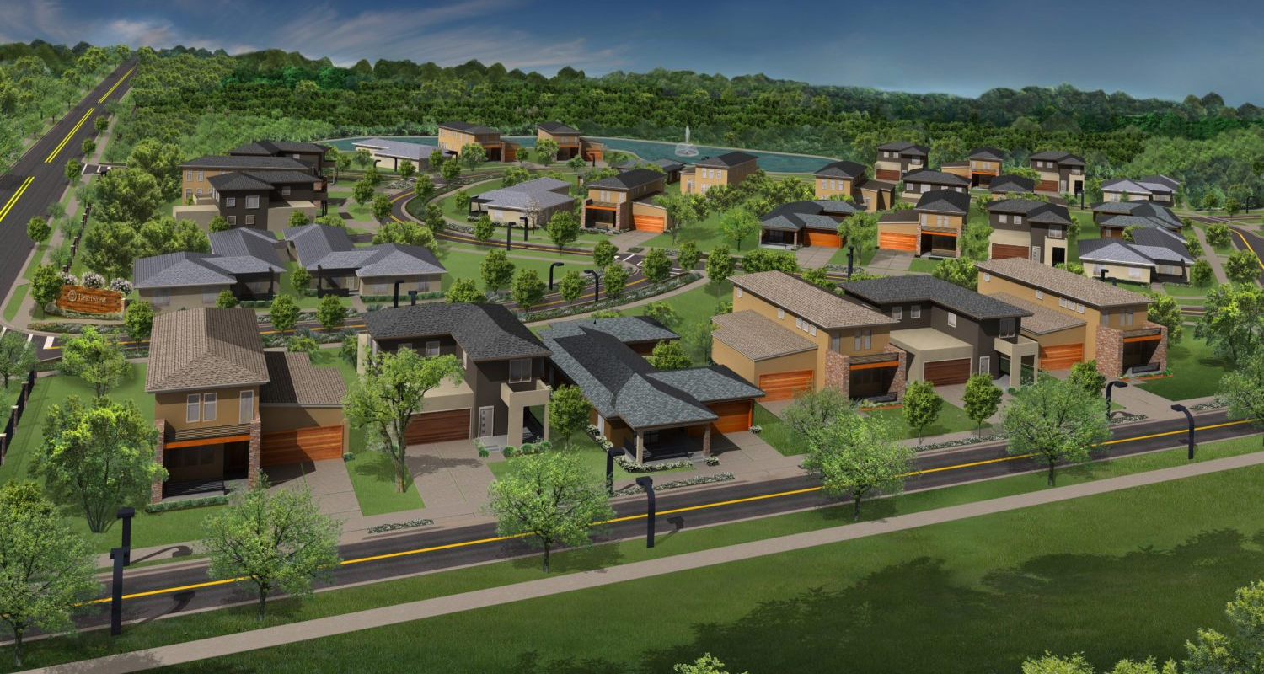
Housing Affordability.

Slide 19
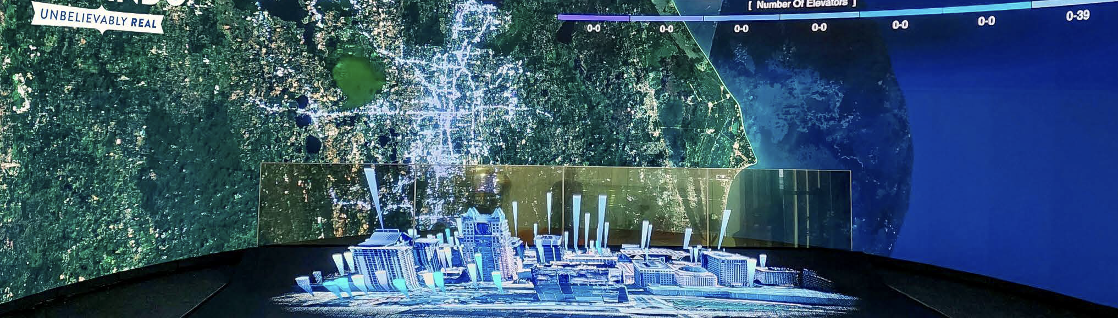
Digital Twins

Slide 20
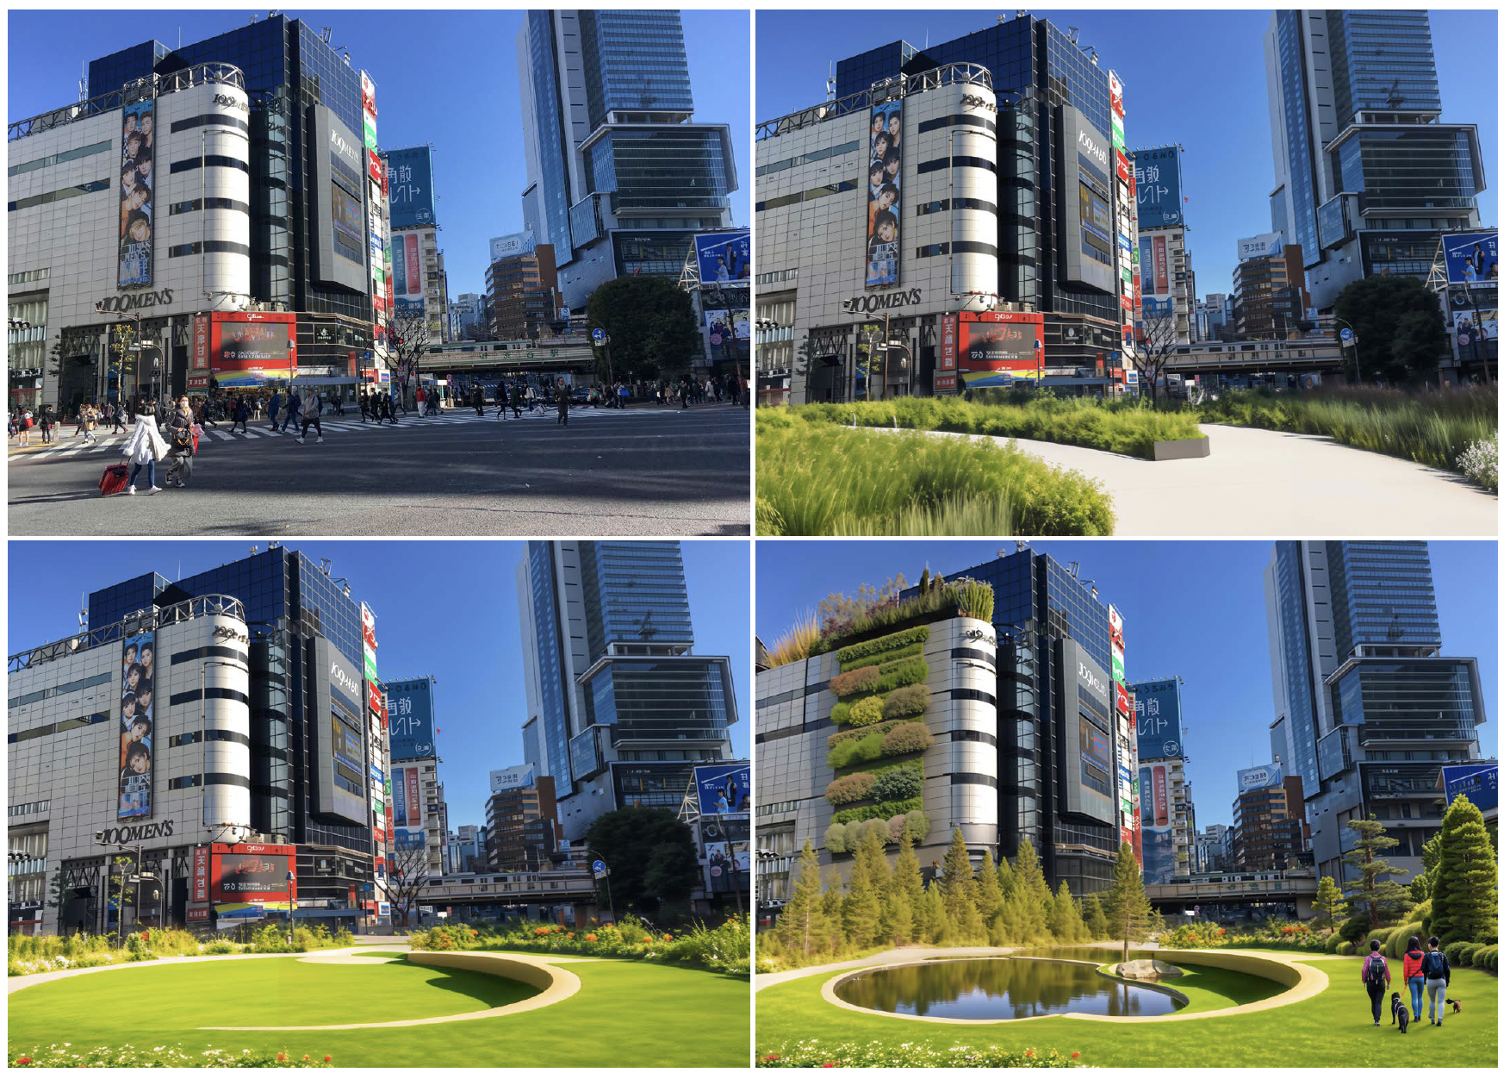
Immersive Cities

Slide 21

Urban Air Mobility

Slide 22
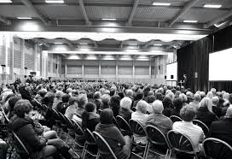
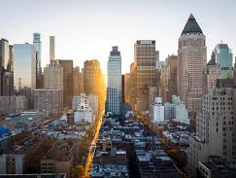

How Can You Get
Involved in Planning?

Slide 23

UF Urban & Regional Planning
01
Undergraduate Minor
02
Bachelor of Urban Sciences & Planning
Master of Urban and
Regional Planning
03
PhD Concentration
in URP
04

Slide 24
15 credit hours
2 core classes:
URP 4000 & URP 3001
3 elective classes
Undergraduate Minor

Slide 25

Bachelor of Urban Sciences & Planning
Fall 2026
Planning, Spatial Analytics, & Urban Analytics
Internship & Studio Capstones

Slide 26
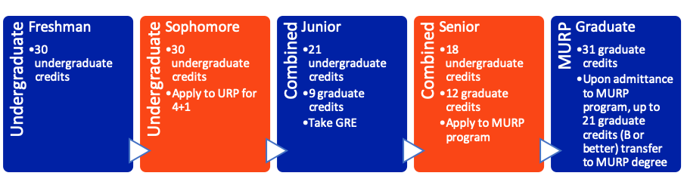
Combined MURP Degree (4+1) Program

Slide 27

Master of Urban and Regional Planning
Learn
Discover
Connect
Engage
Foundations of Planning, Specializations
Research Centers, Thesis
Internship, Mentorship, Professional Development
SPA, GNV, Study Abroad

Slide 28

Get Involved Locally
Vote!
Local Advisory Boards
Local Organizations

Slide 29

Laura Dedenbach, Ph.D, AICP
Instructional Assistant Professor
Interim URP Chair
466 Antevy Hall
laurajd@ufl.edu

