Slide 1

Sea Level Rise Planning & Tools
Kate Norris, Assistant Scholar
Geospatial Data Manager & Senior GIS Specialist
University of Florida GeoPlan Center
October 8th, 2025

Slide 2





University of Florida
GeoPlan Center
Established in 1984. Geospatial research and teaching center in the School of Landscape Architecture & Planning.
We support land use, transportation, and environmental planning in Florida with our geospatial expertise.
We build data and tools to inform planning decisions.
We train undergrad + grad students (they are seeking internships & jobs!).
https://www.geoplan.ufl.edu/

Slide 3

Introductions
Name
Hometown
MURP student or other program? Year in program
Study focus
Do you plan to work in field of climate change?
Copy of today’s presentation and more.

Slide 4
Agenda
Sea Level Rise Projections & Impacts
Florida’s Transportation Resilience Initiatives
Sea Level Scenario Sketch Planning Tool
Demo: Sketch Tool & Resilience Report
Group Exercise
Other Resilience Resources
Accessing FGDL Metadata in ArcGIS Pro
GIS Project: Data Management
Notes:
Why the Sea Level Scenario Sketch Planning Tool was developed and how to use it.

Slide 5
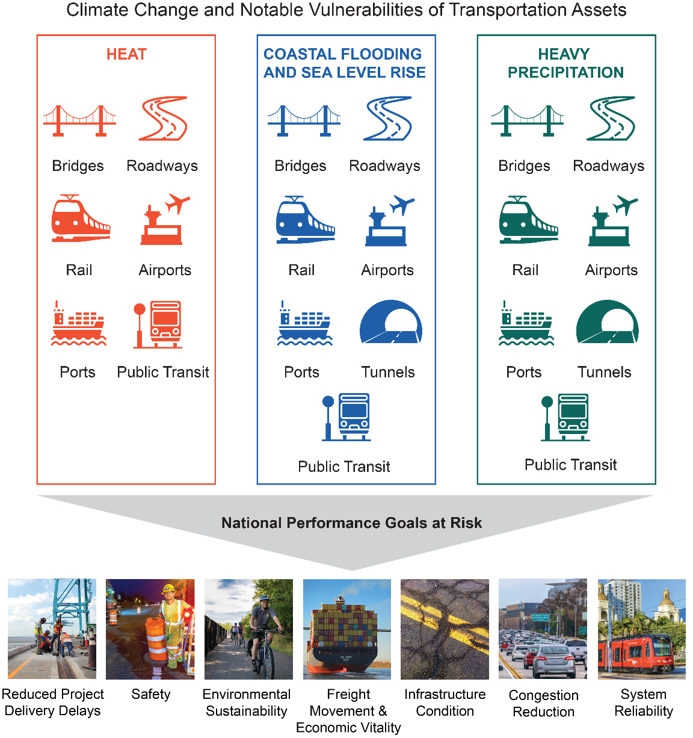
Climate Stressors + Transportation System
Heat - Increased Temperatures
Damage to roads (cracking, buckling, rutting), runways, rails (buckling)
Health risks to outdoor workers and public
Coastal Flooding & Sea Level Rise
More frequent high-tide flooding and more intense tropical storms > flooding and overtopping of assets
Direct and indirect economic damages from system disruption and re-routing
Increased Precipitation and Inland Flooding
Extreme and heavy rain events > increased runoff, erosion, landslides, risk of washout
Increased riverine flooding – overtop and damage roads and bridges; increased bridge scour
U.S. Transportation Assets and Goals at Risk, (Jacobs et al., 2018)

Slide 6
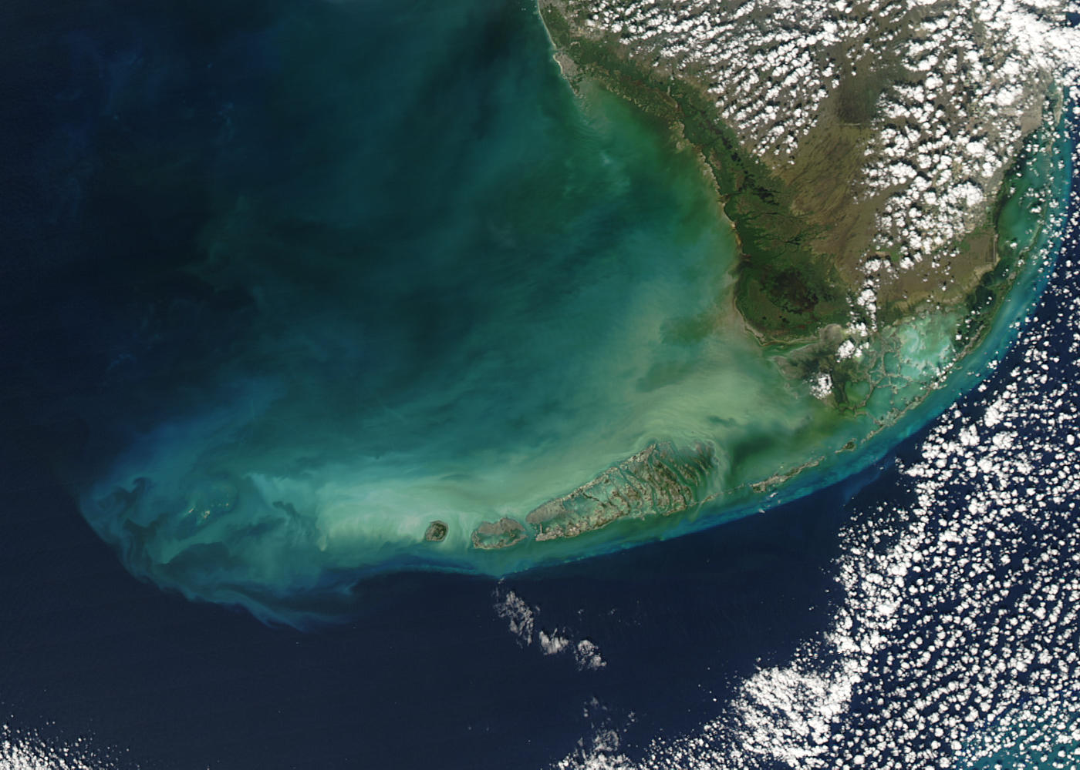
SEA LEVEL RISE PROJECTIONS & IMPACTS

Slide 7
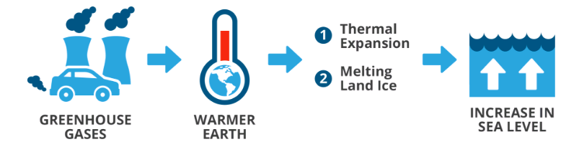
Why are sea levels rising?
Two primary drivers SLR:
Thermal expansion: water expands as it warms (takes up more space)
Glacial melt: melting glaciers and land-based ice sheets add water to the oceans.
Graphic: ECoAS Project: http://www.sealevelrise.ca/
Since 1880s, average global temps rose ~2 degrees F (1 C)
Global sea levels rose about 7 inches
Along contiguous U.S. coast, sea levels rose 11 inches
Noted acceleration since 1970

Slide 8
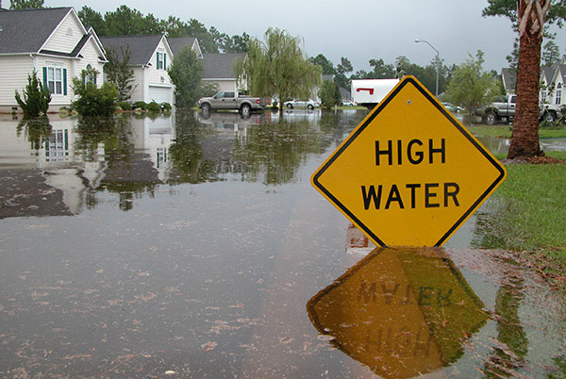
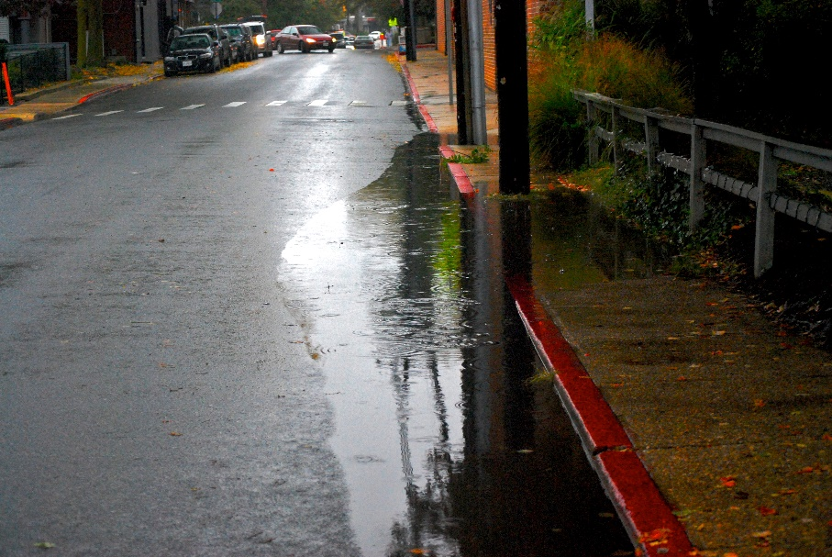
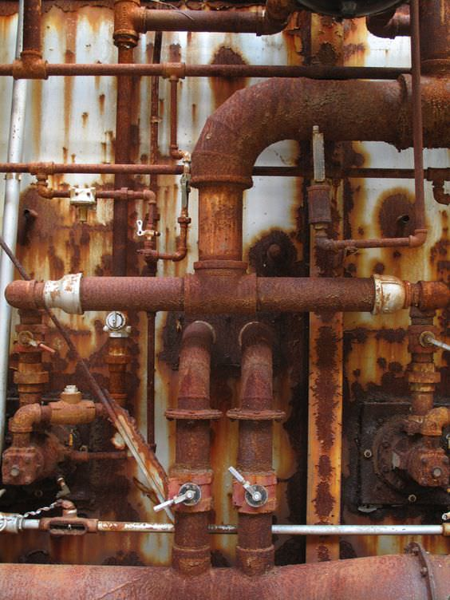
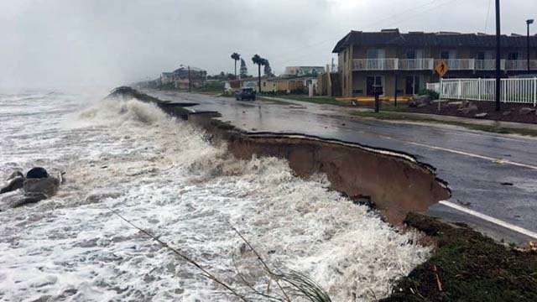
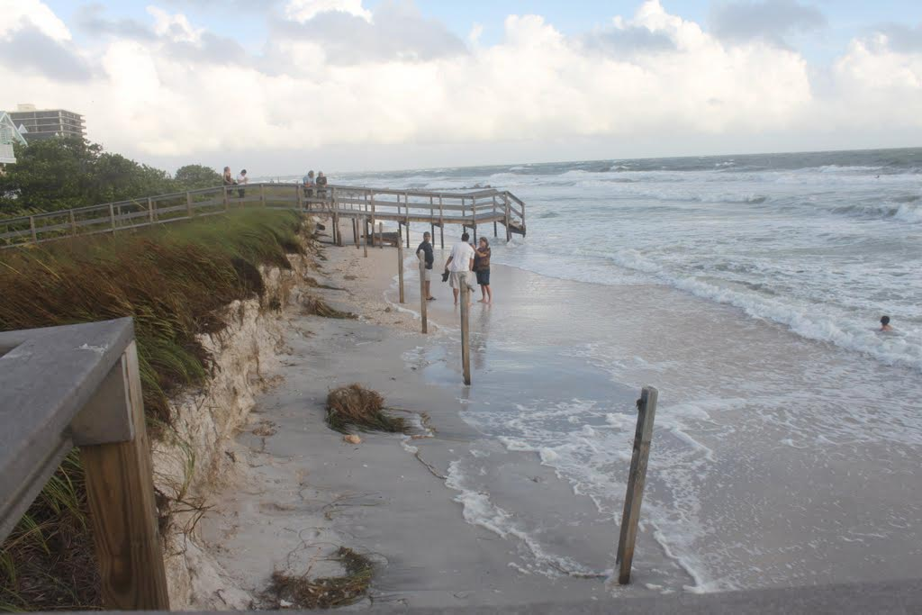
What does sea level rise look like?
SLR is the driver of many impacts:
High tide flooding
Reduced stormwater drainage
Higher storm surges
Increased erosion
Loss of coastal habitats and natural protection
Saltwater intrusion
Images: NOAA, Renee Collini, Chesapeake Bay Program
Notes:
From Sweet, at al – NOAA Tech Report 83 - While the long-term, upward shift in sea level is an underlying driver of changes to the nation’s coasts, impacts are generally expressed through extreme water levels (short-period, lower-probability events both chronic and acute in nature) occurring against the background of this shifting baseline. Higher sea levels worsen the impacts of storm surge, high tides, and wave action (e.g., Theuerkauf et al., 2014), even absent any changes in storm frequency and intensity. Even the relatively small increases in sea level over the last several decades have led to greater storm impacts at many places along the U.S. coast (Parris et al., 2012; Miller et al., 2013; Sweet et al., 2013).

Slide 9
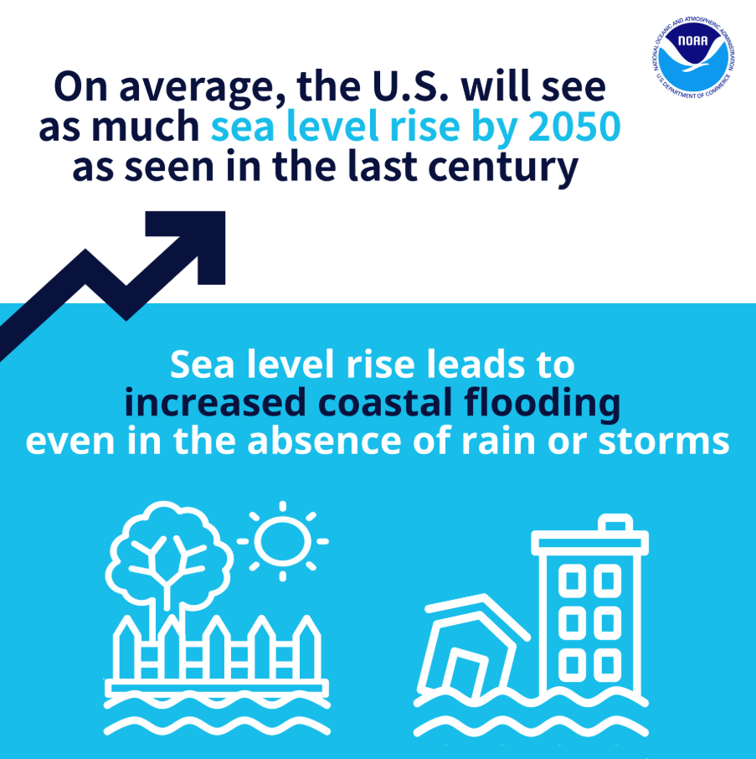
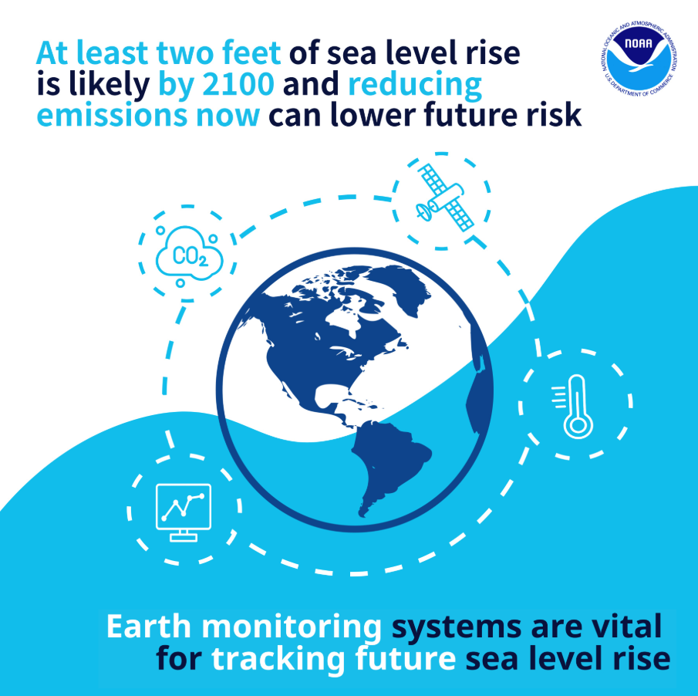
NOAA 2022 Sea Level Rise Technical Report
Source: https://oceanservice.noaa.gov/hazards/sealevelrise/sealevelrise-tech-report-graphics.html
Notes:
Key Takeaways: On average, the U.S. will see as much sea level rise by 2050 as seen in the last century. Sea level rise leads to increased coastal flooding, even in the absence of heavy rain or storms.
Key Takeaways: At least two feet of sea level rise is likely by 2100 and reducing emissions now can lower future risk. Earth-monitoring systems are vital for tracking future sea level rise.

Slide 10
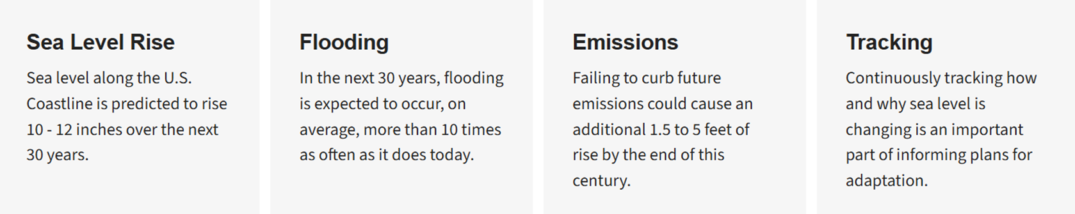
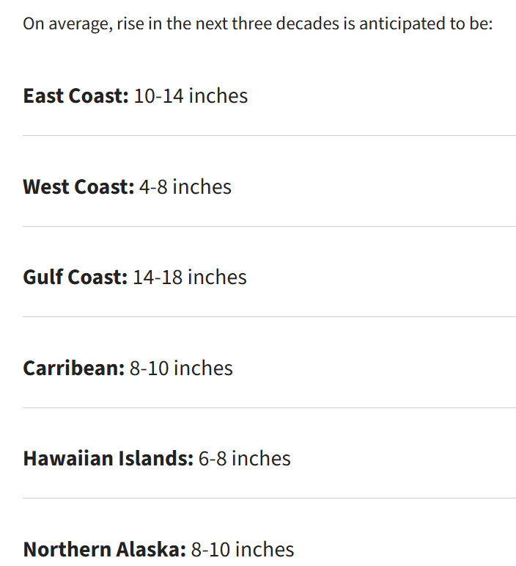
Sea Level Rise Over the Next 30 Years 2020-2050
Sea level rise will vary regionally along U.S. coasts because of changes in both land and ocean height.
The 2022 report provides greater confidence in estimates of sea level rise out to 2050 than the previous 2017 report because of advances in sea level science.
https://earth.gov/sealevel/us/resources/2022-sea-level-rise-technical-report/
Notes:
More Damaging Flooding
Sea level rise will create a profound shift in coastal flooding over the next 30 years by causing tide and storm surge heights to increase and reach further inland.
With this shift, by 2050:
Minor flooding is expected to occur, on average, more than 10 times as often as it does today, and can be intensified by local factors.
Moderate flooding will occur more frequently than minor flooding does today.
Major flooding is expected to occur five times as often as it does today.
Coastal flooding can be exacerbated by many factors that are not included in these estimates, such as rainfall, river discharge, wave impacts like coastal erosion, and existing infrastructure.
Without additional risk reduction measures, U.S. coastal infrastructure, communities, and ecosystems will face increased impacts.
Emissions Matter
Current and future emissions will determine the amount of additional rise in the future: the greater the emissions, the greater the warming, and the greater the likelihood of higher sea levels.
Because of emissions to date, 2 feet of sea level rise will likely occur along the U.S. coastline between 2020 and 2100. Failing to curb future emissions could cause an additional 1.5 to 5 feet of rise, for a total of 3.5 to 7 feet .
Above 5.5°F of global warming, much greater sea level rise becomes possible for the U.S. and globally because of the potential for rapid melting of ice sheets in Greenland and Antarctica. The amount of additional warming required to trigger this is unknown because ice sheet instability is difficult to model and there is great variability in current modeling approaches.
This report provides greater confidence in estimates of sea level rise out to 2050 than the previous 2017 report because of advances in sea level science, as captured in the Intergovernmental Panel on Climate Change’s Sixth Assessment Report, and the use of multiple lines of evidence: both the trends in the amount of relative sea level rise already observed and the models of future sea level rise closely match one another in the next 30 years.

Slide 11
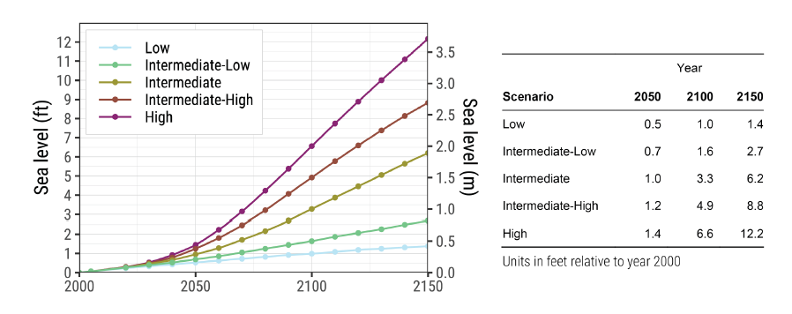
Long-term Sea Level Rise Scenarios
NOAA 2022 - Updated SLR Scenarios (NOAA 2022 Technical Report, Sweet et al., 2022).
Five scenarios of sea level change through 2150
Reflects greater certainty and narrower range of SLR through 2050
NOAA Application Guide (Collini et al., 2022)
Notes:
The five scenarios (Low, Intermediate-Low, Intermediate, Intermediate-High, and High) correspond to average global SLR magnitudes in the year 2100 (relative to a baseline of 2000; Figure 1).
https://www.climate.gov/news-features/understanding-climate/climate-change-global-sea-level
One piece of good news: the task force concluded that an extreme possibility (8.2 feet above 2000 levels by 2100) that they couldn’t rule out at the time of their 2017 report appears to be less likely based on the latest science. This doesn’t mean global sea level rise of that much won’t ever happen, only that it is extremely unlikely to happen by 2100. Still, on a pathway with high greenhouse gas emissions, if processes triggering rapid ice sheet collapse kick in, global sea level could rise upwards of 3.7 meters (12 feet) higher in 2150 than it was in 2000.
Now the bad news: the report reaffirmed that many parts of the United States can expect their local rate and overall amount of sea level rise to exceed the global average. Extrapolating from observed rates, sea levels on average along the contiguous U.S. are expected to rise as much over the next 30 years (10-12 inches over 2020-2050) as they have over the last 100 years (1920-2020). In some regions, the increases will be even larger. In the western Gulf of Mexico, for example, sea level rise is likely to be about 16-18 inches higher than 2020 levels by 2050—almost a ½ foot higher than the national average.
----------------

Slide 12
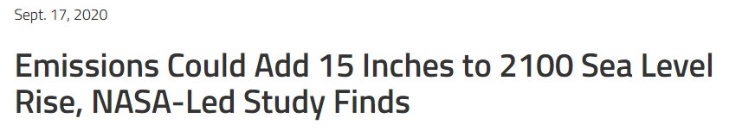
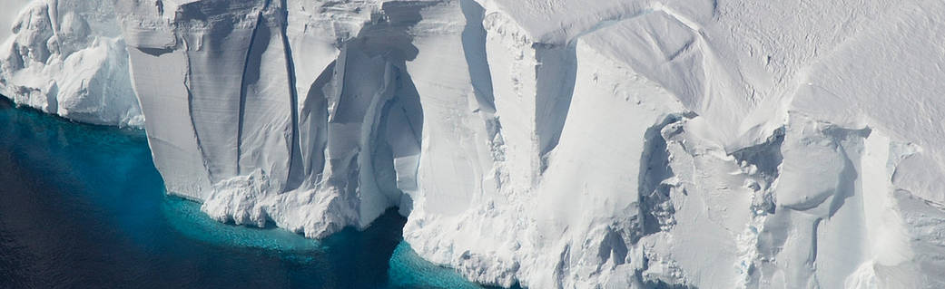
Why such a large range of future sea levels?
Unknown amount of future carbon in the atmosphere (i.e. how much will we keep heating up the earth?)
Natural variability in global temperatures
Emerging science on ice sheet melt
https://www.nasa.gov/feature/goddard/2020/emissions-could-add-15-inches-to-2100-sea-level-rise-nasa-led-study-finds
Notes:
“One of the biggest uncertainties when it comes to how much sea level will rise in the future is how much the ice sheets will contribute,” said project leader and ice scientist Sophie Nowicki,
From study - If greenhouse gas emissions continue apace, Greenland and Antarctica’s ice sheets could together contribute more than 15 inches (38 centimeters) of global sea level rise – and that’s beyond the amount that has already been set in motion by Earth’s warming climate.
Meltwater from ice sheets contribute about a third of the total global sea level rise. The IPCC report projected that Greenland would contribute 3.1 to 10.6 inches (8 to 27 cm) to global sea level rise between 2000-2100 and Antarctica could contribute 1.2 to 11 inches (3 to 28 cm).
Ice loss from the Antarctic ice sheet is more difficult to predict: In the west, warm ocean currents erode the bottom of large floating ice shelves, causing loss; while the vast East Antarctic ice sheet can gain mass, as warmer temperatures cause increased snowfall.
The melting of Antarctica's ice sheet is currently responsible for 20 to 25 percent of global sea level rise.
https://climate.nasa.gov/news/2869/antarcticas-effect-on-sea-level-rise-in-coming-centuries/

Slide 13
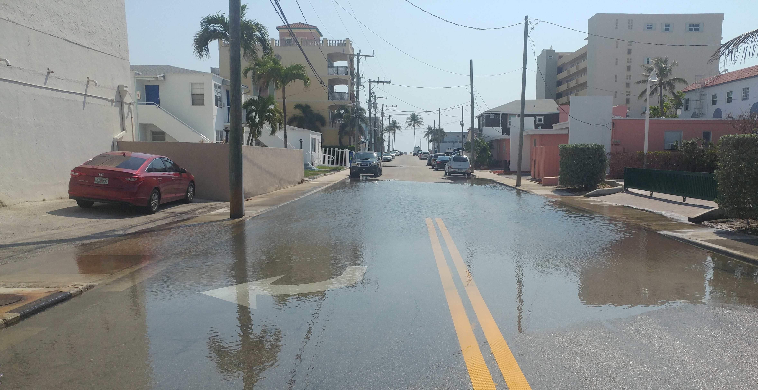
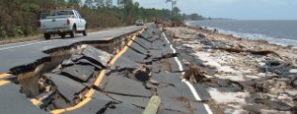

What does this mean for transportation?
Short-to-mid term
Episodic flooding increasing
Mid-to-long term
Episodic + Permanent flooding
Facilities: flooded, damaged, inaccessible
Increased $ -maintenance/ repair
Safety issues
Mobility & economic disruptions
Reduction of tax base & services
Permanent inundation in some areas
Changes in where people live and work
Need to increase resilience of transportation systems
Notes:
Redundancy, diversity, flexibility, adaptability

Slide 14
FHWA Vulnerability Assessment & Adaptation Framework
Define objectives & scope
Compile Data
Assess Vulnerability
Asset data, Climate Stressors
Adaptation Options
Incorporate Results into Decision-Making
Determine climate stressors, timeframe, assets
LRTPs, Hazard Mitigation, Asset Mgmt
Assess risk, stakeholder input, narrow options
Identify, Analyze, Prioritize Adaptation Options
MONITOR AND REASSESS
SLR is often one part of a larger process
Other stressors and factors considered in planning process
Process is cyclical and needs to be revisits as better data, models, and science are developed
Notes:
This is the FHWA VA framework.
I’m not going to go into exhaustive detail of it – but I include it here to show you that our data and SLR in general is part of a larger planning process.
Undoubtedly, SLR is one of the most serious issues facing Florida, but there will be other compounding issues to assess/
If using Renee’s Risk-based approach, you’d define that in step 1: define objectives and
Risk is a measure that includes both the probability that an asset will experience a particular impact, and the consequence (or severity) of that impact.
Vulnerability of what to what?
Involve climate scientists, professionals, public (throughout process)
Determine audience and stakeholders
Determine Climate Stressors:
SLR related: Inundation, storm surge & waves, nuisance flooding
Precipitation Changes
Saltwater intrusion and aquifer storage
Temperature
Scale/ geography and level of detail needed:
Project Level, City-wide, Region-wide
Assets/ Systems to Evaluate
Entire city? Critical facilities? Ecosystems? Water resources? Socioeconomic?
When are you planning for?
Data Collection
Data on climate stressor (models for SLR, precip, storm surge, etc)
Data on areas/ assets you are assessing: elev, property, socio-eco and demographic data, storm water, critical habitats and species, etc).
Identify Vulnerabilities
Tons of tools out there!
Usually involves GIS overlay & analysis
Identification of tipping points
Assess Risk
Now you know what’s vulnerable – what do you want to do about it?
Continue the conversation with community and stakeholders. Build public support.
Determine Strategies to address identified vulnerabilities
Develop policies that support resilient decision making and expenditures.
Comp Plans and LDRs
Long-range Transportation Plans
Hazard Mitigation Plans
Prioritize public spending
Capital Improvement Program (public infrastructure)
Transportation Improvement Program

Slide 15
Sea Level Scenario
Sketch Planning Tool
“The purpose of the Sea Level Scenario Sketch Planning Tool is to help identify transportation infrastructure exposed to current and future flood risks.”
Notes:
Today, discussing the update to the Sketch Planning Tool and how to choose scenarios and get scenario data .
Short live demo on using the map viewer and getting data
How to view scenarios and get data

Slide 16
Sketch Tool Goals
Our tools seek to:
Support FDOT’s goals of increasing transportation resilience by developing geospatial tools to facilitate assessment of infrastructure vulnerable to flooding.
Facilitate resiliency decision making by increasing accessibility and utilization of climate data.
Our tools support:
FDOT’s Resiliency Policy 000-525-053
2045 Florida Transportation Plan (FTP): Goal of Agile, Resilient, and Quality Transportation Infrastructure
Notes:
This project seeks to support FDOT’s goals of increasing transportation resilience by developing geospatial tools to facilitate vulnerability assessment of infrastructure to flooding and help identify risks.
FDOT’s Resiliency Policy 000-525-053:
Identify risks, particularly related to sea level rise, flooding, and storms; assess potential impacts; and employ strategies to avoid, mitigate or eliminate impacts.
Implement resiliency through long-range and modal plans; work program; management plans, research efforts, and internal manuals, tools, guidelines, procedures, and related documents.
FTP 2045: Goal of Agile, Resilient, and Quality Transportation Infrastructure.
Progress Indicators: Vulnerability to flooding or storm surge

Slide 17
Planning for Transportation System and Transportation Project Development Phases
Long Range Planning
Right of Way
Project Development & Environment (PD&E)
Design
Construction
Operations & Maintenance
FDOT and partners have found transportation system resiliency is not always a linear process starting with planning and ending with operations and maintenance.
Instead, FDOT and partners have been figuring out how best to increase resiliency on multiple fronts at the same time, learning along the way.

Slide 18
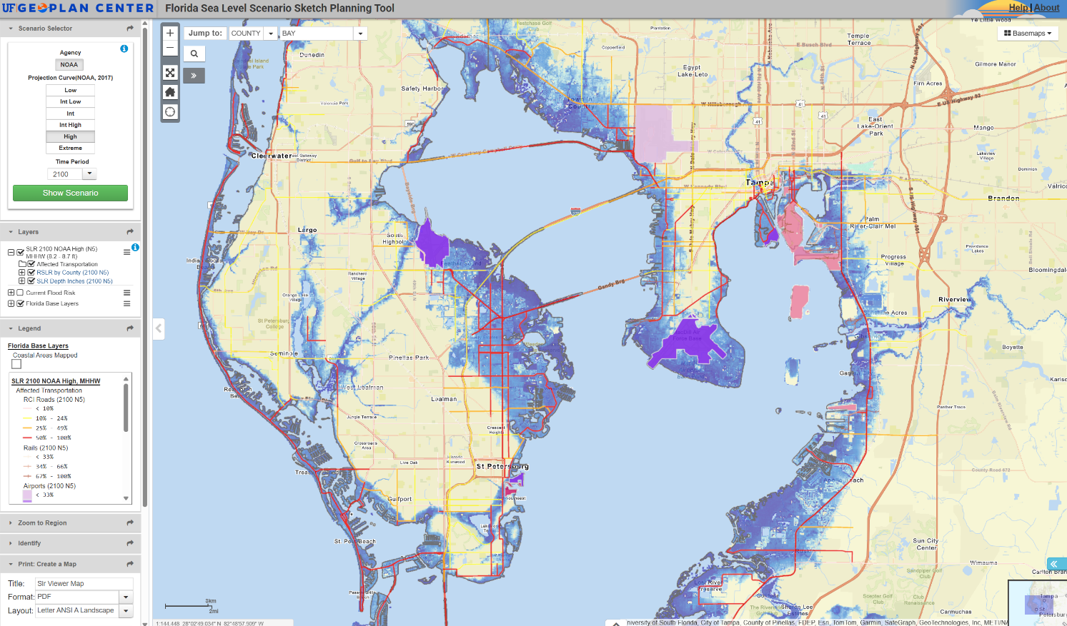
About the Sketch Planning Tool
Sea Level Scenario Sketch Planning Tool provides planning-level analyses of where and when SLR may impact the transportation system.
Offers broad context, but wanted to allow for project level impacts.
Requests from users to integrate SLR information into ETDM/ EST.
Launched in 2013, the current 2022 SLR Viewer will be updated with new 2025 data in December 2025.

Slide 19
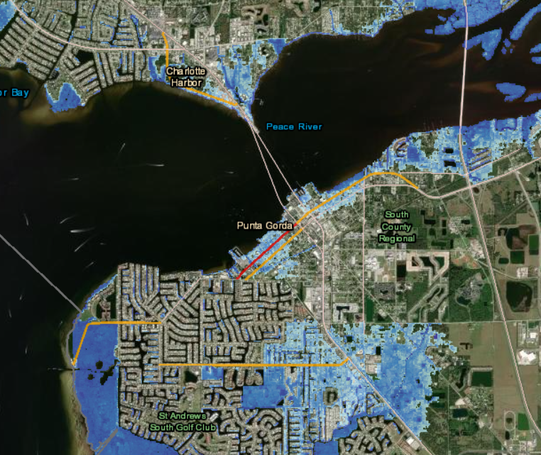
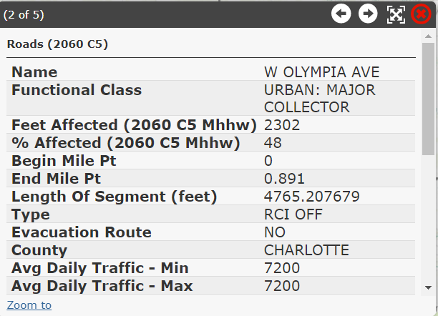
Transportation Exposure Analysis
Transportation assets analyzed:
Roadways (RCI and Tiger)
Airports, seaports, freight terminals, rails
SIS designations
Segment and asset-level analysis:
  Future flood risk: NOAA SLR scenarios over 7 decades
  Current flood risk: 100-year & 500-year floodplains, storm surge zones

Slide 20
Demo
Notes:
Today, discussing the update to the Sketch Planning Tool and how to choose scenarios and get scenario data .
Short live demo on using the map viewer and getting data
How to view scenarios and get data

Slide 21
Demo
SEA LEVEL SCENARIO SKETCH PLANNING TOOL
https://sls.geoplan.ufl.edu/
Video Tutorials:
Playlist 1: Getting Started (Sea Level Scenario Sketch Planning Tool)
A playlist of eight tutorial videos on YouTube explaining the basics of the Sea Level Scenario Sketch Planning Tool.
    https://www.youtube.com/watch?v=SBH0AVckuRk&list=PL9PqgrAleEXMtLobFxl8qBJOhxM6Nu6zH
Playlist 2: More Widgets and Tools (Sea Level Scenario Sketch Planning Tool) A playlist of eight additional tutorial videos on YouTube explaining how to use specific widgets and tools in the Sea Level Scenario Sketch Planning Tool.
    https://www.youtube.com/watch?v=ksuszTz_d9k&list=PL9PqgrAleEXMXkiRMpLo1jl06rFNRSxcc
Notes:
Today, discussing the update to the Sketch Planning Tool and how to choose scenarios and get scenario data .
Short live demo on using the map viewer and getting data
How to view scenarios and get data

Slide 22
Exercise

Slide 23
Vulnerability Assessment Exercise
Work in groups of 2-3 people
Log into Sketch Planning Tool Viewer: sls.geoplan.ufl.edu/viewer
Choose a coastal area to explore (first city level)
Choose 2 NOAA SLR Scenarios and 2 time periods
  Ex: Intermediate-Low and Intermediate-High at 2050
  Ex: Intermediate-High at 2050 and 2100
Explore affected roads (identify tool and/or attribute table, use swipe tool).
Create at least 2 Maps of the different time periods and scenarios
Give a short report of your findings!
Notes:
Same projection, different time period.
Single time period, Range, low vs high
Hamburger bun to download map package they are looking at

Slide 24
Resources
Notes:
Today, discussing the update to the Sketch Planning Tool and how to choose scenarios and get scenario data .
Short live demo on using the map viewer and getting data
How to view scenarios and get data

Slide 25
SLR Resources
UF GeoPlan Center: Sea Level Scenario Sketch Planning Tool
  https://sls.geoplan.ufl.edu/
NOAA 2022 Sea Level Rise Technical Report
  https://earth.gov/sealevel/us/resources/2022-sea-level-rise-technical-report/
NOAA 2022 Sea Level Rise Technical Report Application Guide
  https://earth.gov/sealevel/us/resources/2022-sea-level-rise-technical-report/#application-guide-download
NOAA Sea Level Rise Viewer
  https://coast.noaa.gov/digitalcoast/tools/slr.html
USACE Sea Level Analysis Tool (SLAT):
  https://climate.sec.usace.army.mil/slat/
Florida Geographic Data Library (FGDL)
  https://www.fgdl.org
Crystal Goodison, Ph.D
Associate Scholar + Associate Director
University of Florida GeoPlan Center
Sea Level Scenario Sketch Planning Tool Project PI
cgoody@ufl.edu

Slide 26
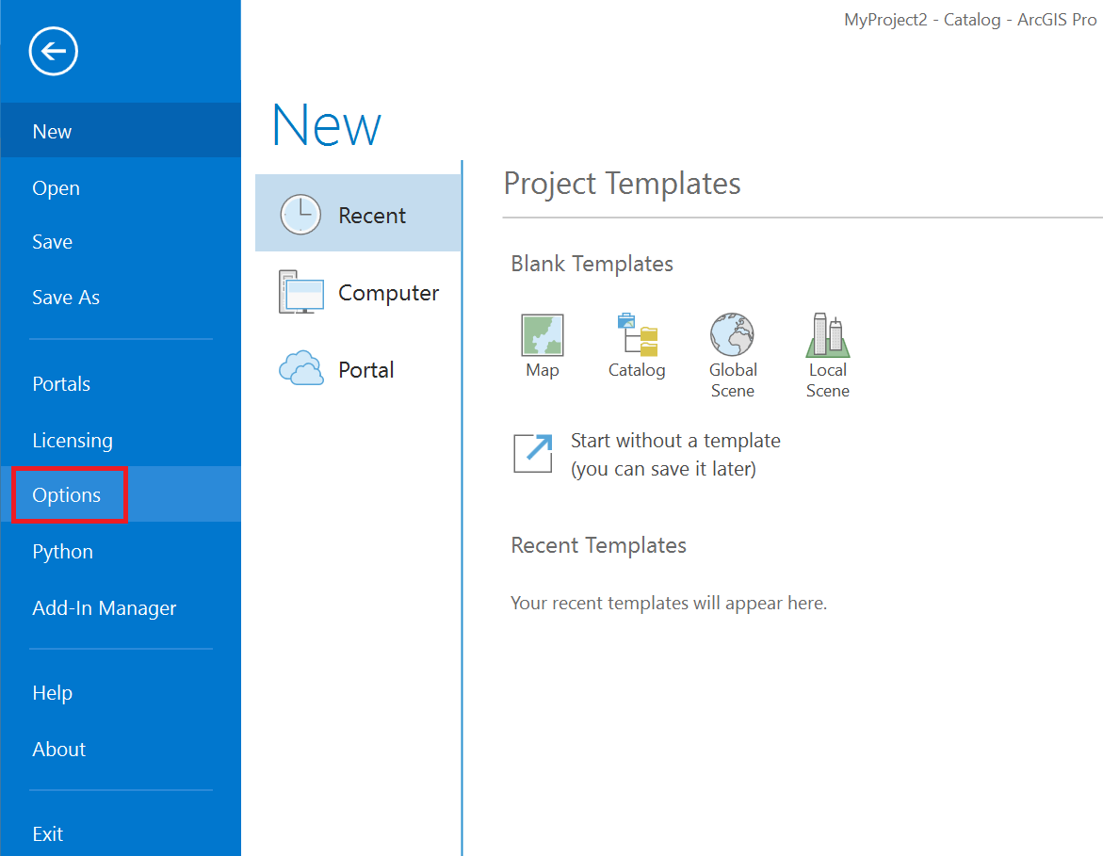
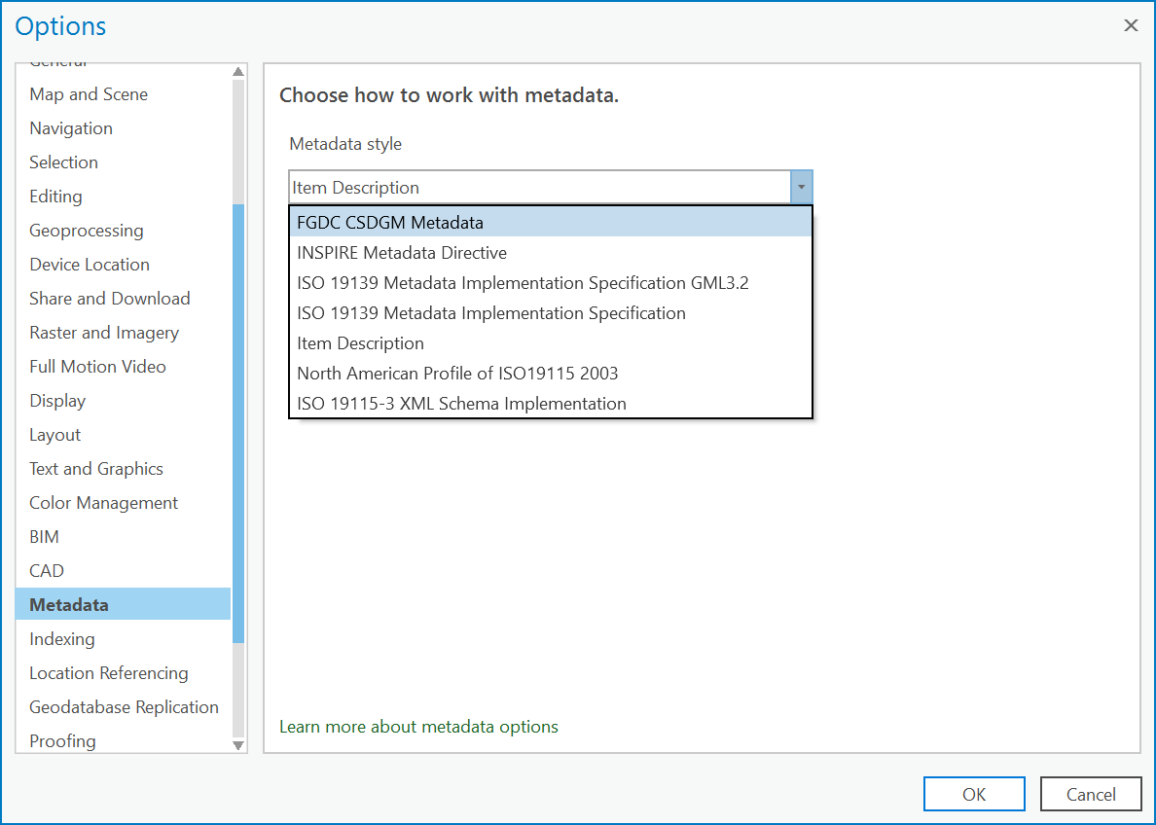
Accessing FGDL Metadata in ArcGIS Pro
Changing the default Metadata Style.
  FGDC CSDGM Metadata: “This style lets you view and edit metadata following the FGDC Content Standard for Digital Geospatial Metadata (CSDGM) guidelines, export metadata in this standard's XML format, and validate it using the CSDGM XML DTD.”
    ~ESRI

Slide 27
GIS Project: Data Management
Data Collection and Tracking
  Table Example: GIS_Project_Data_Management_Table_20250115.xlsx
    QR Code: https://adhoc.geoplan.ufl.edu/downloads/kate/GIS_Project_Data_Management/
(Us/State/County/City)
  Filename
  Description
  Source
  Source Date
  Date Downloaded
  Feature Type
  Extent
  Record Count
  Download Link
  Metadata Link
  Zip File Name
  Original File Name
  Local Directory
  Original Projection (PRJ)
  Projected
  Projected Transformation
  Notes
  Who Downloaded (Group Projects)

Slide 28
GIS Project: Data Management
Garbage In, Garbage Out (GIGO)
Critical Thinking and Dirty Data (tabular and spatial)
  Tip: Uppercase Fields for Summaries.
  Tip: Geocode accuracy can vary in Urban vs Rural areas.
Get all of your data projected to a single coordinate system
  If you are doing area and length calculations/summaries project your data to a Projected Coordinate System (i.e. not WGS84)
Accessing and Reviewing Metadata
Data Clean-up and Documentation
“CYA” ~ Dr. Paul Zwick
  Don’t make assumptions about downloaded data or fields
  Know what the data was originally created for
  Look things up, do some digging, and read the metadata
Notes:
Find Land Use Data Hands On Small Group

Slide 29

Thank you!
https://www.fgdl.org
https://www.geoplan.ufl.edu
Data Questions + Listserv Signup:
https://fgdl.org/info/contact/
Kate Norris
Knorris@ufl.edu

